Slide 1

Video #6
HARDWARE - 5
BEGINNER TO EXPERT GUARANTEED
ULTIMATE IT COURSE
ACCESS NETWORKING COURSE PLAYLIST LINK IN DESCRIPTION
SUBSCRIBE!!!

Slide 2
Answers
1. VGA is capable to transmit ? (Video/Audio/Data/Radio Signals)
2. Abbrevation of BNC ? Bayonett Neill Concelman
3. Meaning of 10Base-T ? 10 MBPS upto 100 Meters
4. Which is Apple iphone charger Connector ? LIGHTNING CONNECTOR
5. Why HDMI is better then DVI & VGA ?
HDMI transmits HD Video & Audio 2560×1600 while DVI only transmits Low Quality Video and Audio 2560 x 1600 and VGA only transmits Video 640 x 480
Solve all question and comment down answers...

Slide 3
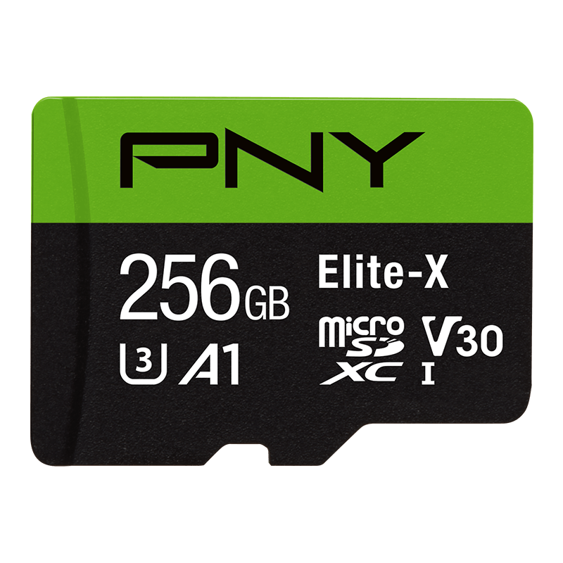
Memory ?
In computing, memory is a device or system that is used to store information for immediate use in a computer or related computer hardware and digital electronic devices.
In the term of computing we measure memory with bits.

Slide 4

What is Bit ?
Most important part in system.
First we know about what is bit.
Computer circuit need power of electricity.
Electricity power mode On and Off
The on and Off is Bit in electricity.
Because the computer are store the data in form off electricity.
In Electricity also called bit.
Only two value in bit 0 and 1 mean on and off.

Slide 5
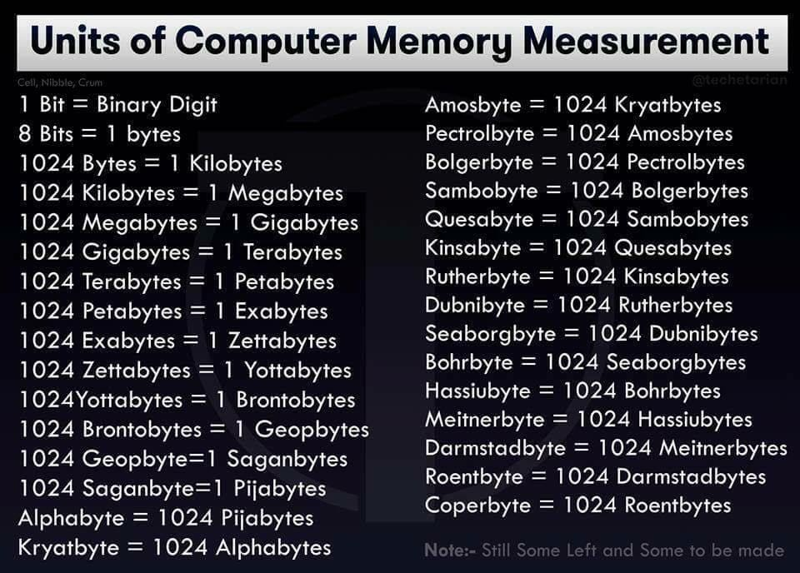

Slide 6
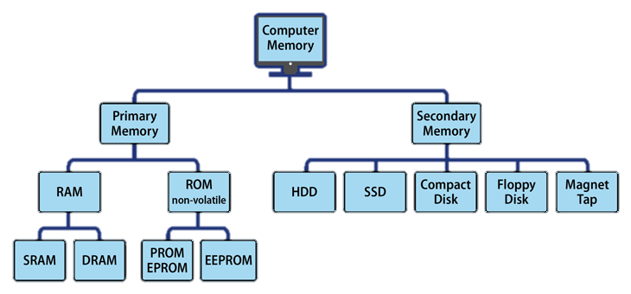

Slide 7
Primary Memory
RAM
SRAM
DRAM
ROM
PROM
EPROM
EEPROM

Slide 8
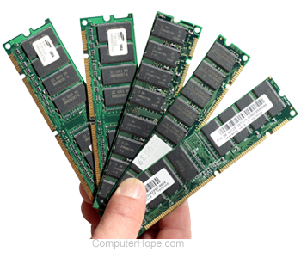
RAM
Computer memory or random access memory (RAM) is your system's short-term data storage; it stores the information your computer is actively using so that it can be accessed quickly. The more programs your system is running, the more memory you'll need. Frequency measures in Mhz.

Slide 9
SRAM
It stores the data in a static form which means that the data remains in the memory as long as the computer system is on. SRAM is faster and more expensive than DRAM. It uses a matrix of six transistors and no capacitors. As the transistors do not need the power to prevent leakage, hence, there is no requirement to refresh SRAM again and again.
DRAM
DRAM is widely used in computer systems. Previously, there was a single data rate (SDR) DRAM in computers. At present, computers are using a dual data rate (DDR) DRAM. DDR is also available in different versions such as DDR2, DDR3, and DDR4, which are more energy-efficient and are providing better performance.

Slide 10
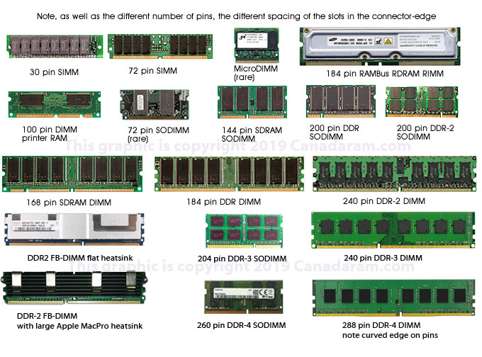
SIMM
DIMM
RDRAM
SDRAM
DDR
DDR2
DDR3
DDR4

Slide 11

ROM
Stores crucial information essential to operate the system like the program essential to boot the computer. It is not volatile.
Used in embedded systems or where the programming needs no change. Used in calculators and peripheral devices.
ROM is further classified into 4 types- ROM, PROM, EPROM, and EEPROM.

Slide 12
PROM
It can be programmed by user. Once programmed, the data and instructions in it cannot be changed.
EPROM
It can be reprogrammed. To erase data from it, expose it to ultra violet light. To reprogram it, erase all the previous data.
EEPROM
The data can be erased by applying electric field, no need of ultra violet light. We can erase only portions of the chip.

Slide 13
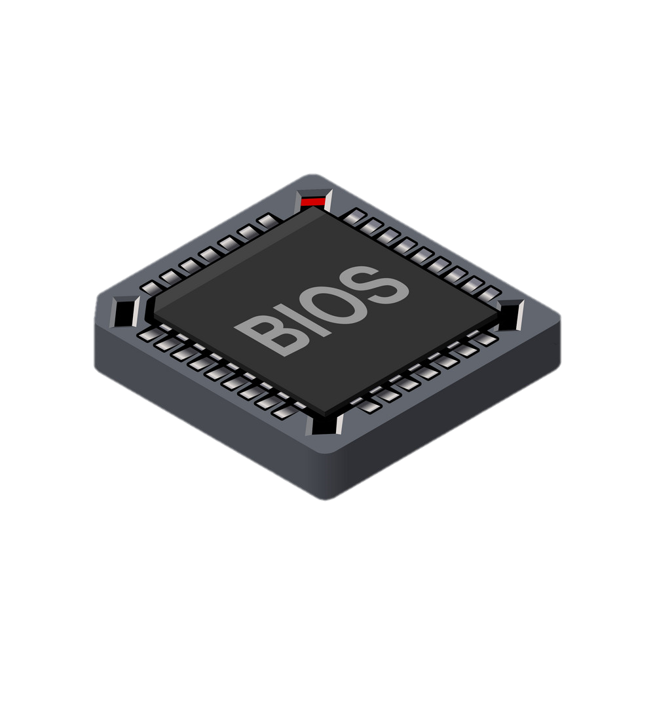
BISO Chip is Type of EPROM ?

Slide 14
Primary Memory
HDD
SSD
Pendrive
Memory Card
CD
DVD
Blu-Ray
Floppy
Audio Tape
Video Tape

Slide 15
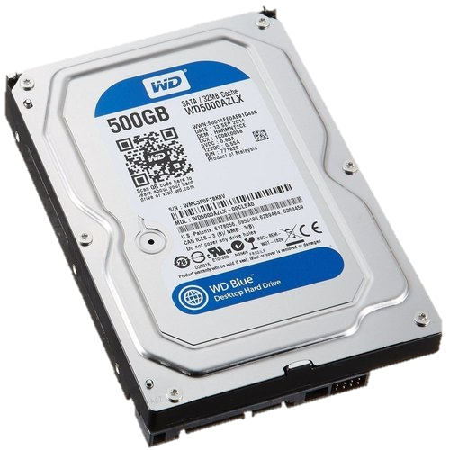
HDD
A hard disk drive (HDD) is a traditional storage device that uses mechanical platters and a moving read/write head to access data.
Unit of HDD is RPM.
SATA (Serial Advanced Technology Attachment) – 7 pins for data 15 pins power 4 pins molex speed upto 600MBPS
SATA 1 - 150 MBPS
SATA 2 - 300 MBPS
SATA 3 - 600 MBPS
IDE (Integrated Drive Electronics) - 40 pins for data 4 pins for Power 4 pins molex speed uto 133MBPS
ATAPI – I - 100MBPS
ATAPI – II - 133MBPS

Slide 16
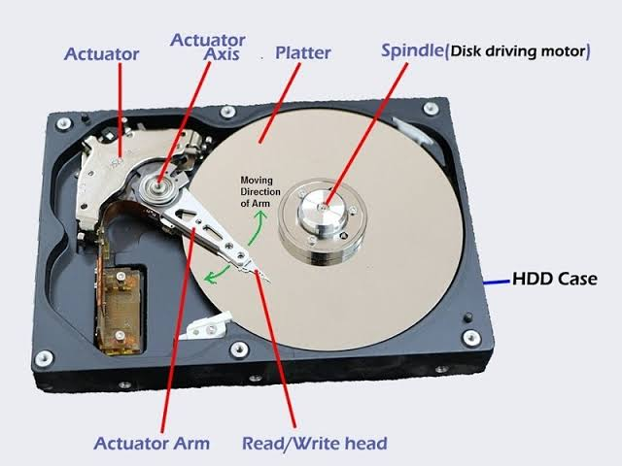

Slide 17
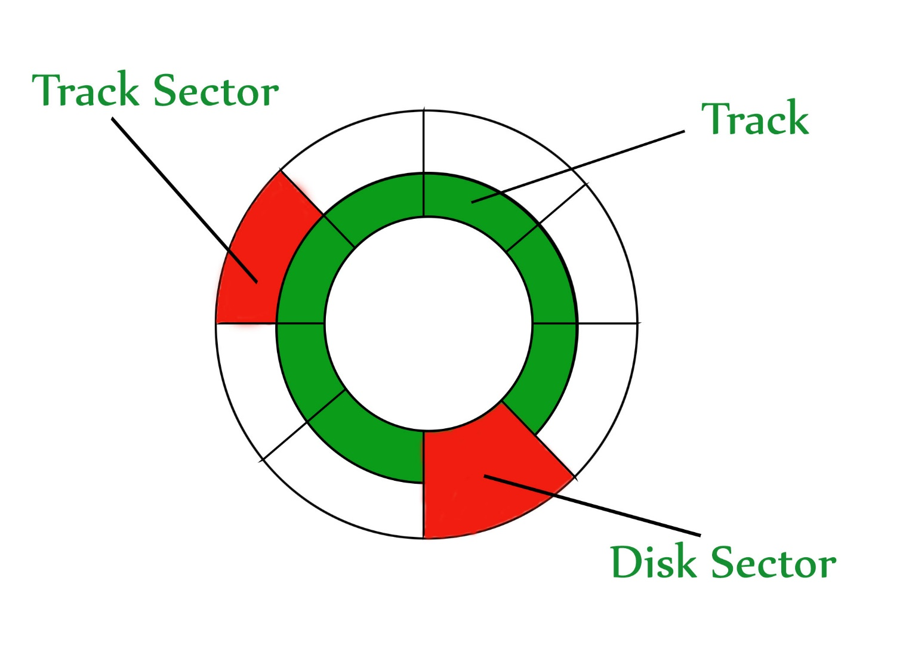
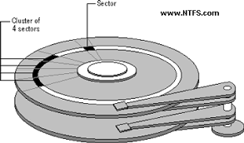

Slide 18
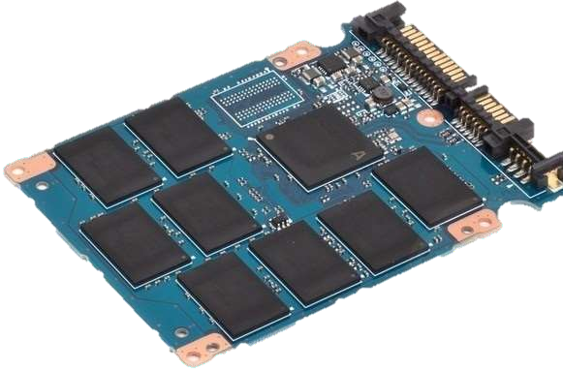

SSD
Solid State Drive, is one of the newest generation of storage device that's used for PCs and Laptops. In contrast to traditional Hard Disk Drives or HDD, a memory consisting of semiconductors is used to store data.
High performance-Significantly faster than a standard HDD.
Faster seek time-Up to 60x faster than HDD.
Higher reliability-No moving parts.
Lower power-Lesser power consumption, cooler operation.
Silent Operation-Ideal for post production environments.
Light weight-Perfect for portable devices.
Wider Operating Temp.

Slide 19
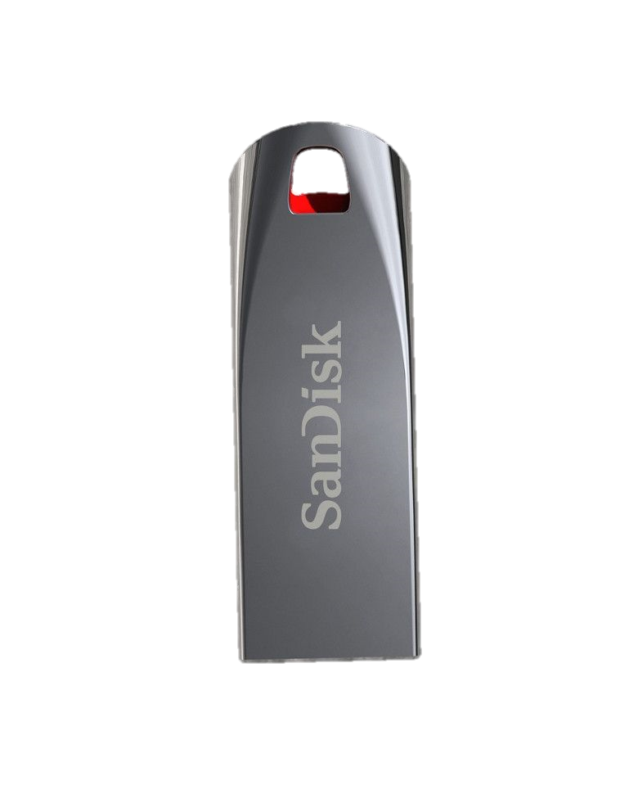
Pendrive
The definition of a pen drive is small storage device shaped like a pen with built-in data storage that connects to a computer by a USB port. An example of a pen drive is a pen with a hidden USB port for saving data.
Characteristics
These are able to store large amounts of data in a small chip.
Next, my product can store data such as pictures, songs, files, and etc.
Pendrive are Portable and plug and play device.
It can only be connected to a device that has a usb port

Slide 20
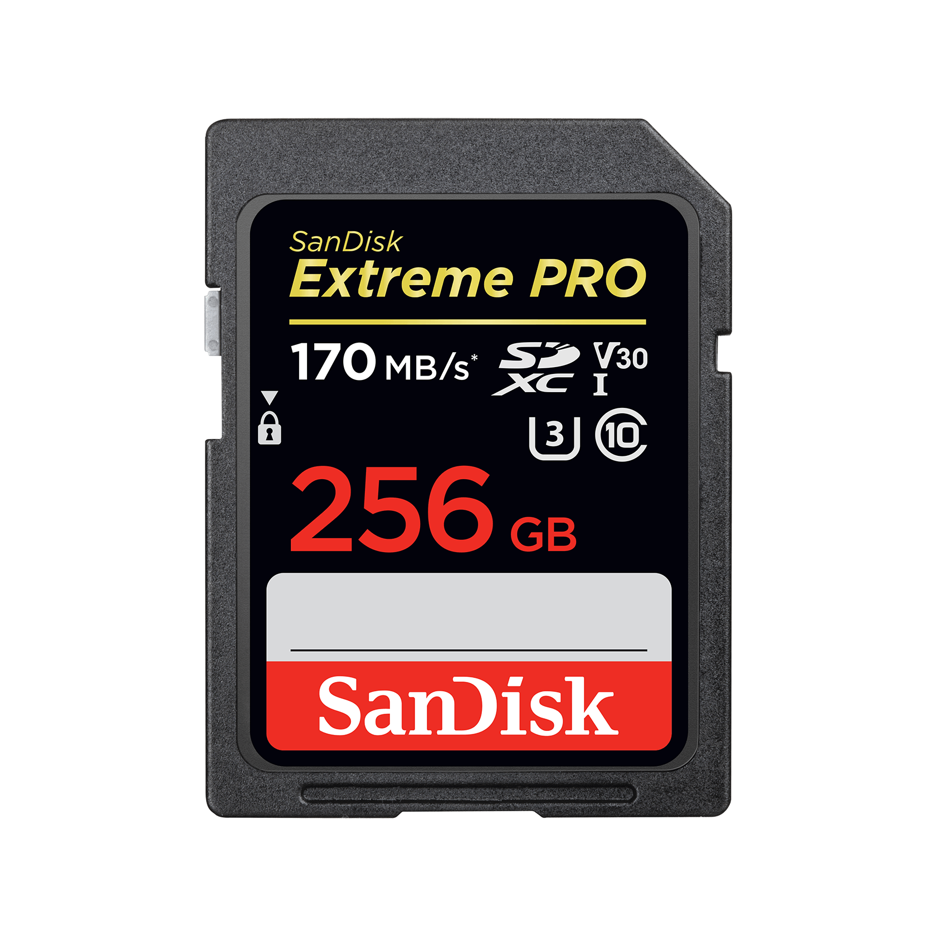
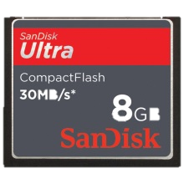
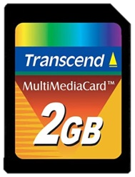
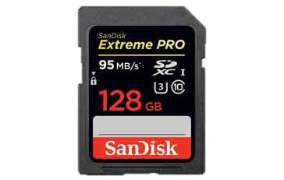
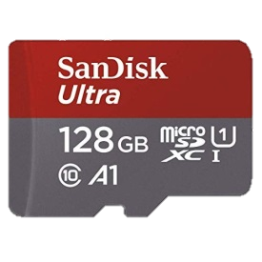
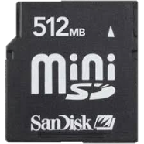
Memory Card
A memory card or memory cartridge is an electronic data storage device used for storing digital information, typically using flash memory.You can store music, pictures, videos & documents etc in memory cards. It uses in different different devices like mobiles, camera, ipod & home theatres etc.
Compact Flash
Multimedia Card
Secure Digital Card
Micro SD
Mini SD Card

Slide 21
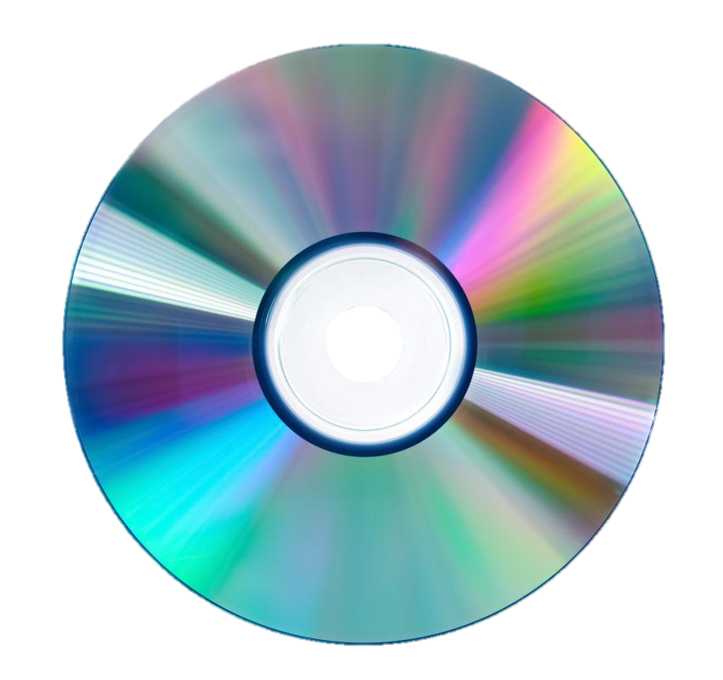
CD
A Compact Disc, also called a CD are small plastic discs which store and retrieve computer data or music using light. ... CDs that have computer information on them are called CD.
CD-ROM
(Compact Disc-Read Only Memory) only readable.
CD-R
(Compact Disc-Read Only Memory) only recordable.
CD-RW
(Compact Disc-Read Only Memory) can be rewritable.

Slide 22
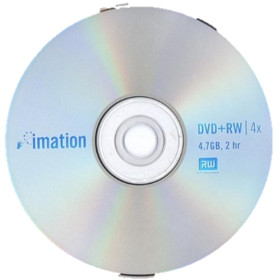
DVD
"Digital Versatile Disc." A DVD is a type of optical media used for storing digital data. It is the same size as a CD, but has a larger storage capacity. Some DVDs are formatted specifically for video playback, while others may contain different types of data, such as software programs and computer files Size is 4.7 GB.
DVD-ROM
(Compact Disc-Read Only Memory) only readable.
DVD-R
(Compact Disc-Read Only Memory) only recordable.
DVD-RW
(Compact Disc-Read Only Memory) can be rewritable.

Slide 23
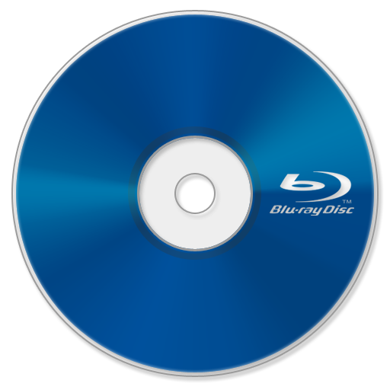
Blu-ray Disc
The Blu-ray Disc, often known simply as Blu-ray, is a digital optical disc storage format. It is designed to supersede the DVD format, capable of storing several hours of video in high-definition video. Size is 25, 50 & 100 GB.
BD-ROM
(Compact Disc-Read Only Memory) only readable.
BD-R
(Compact Disc-Read Only Memory) only recordable.
BD-RW
(Compact Disc-Read Only Memory) can be rewritable.

Slide 24
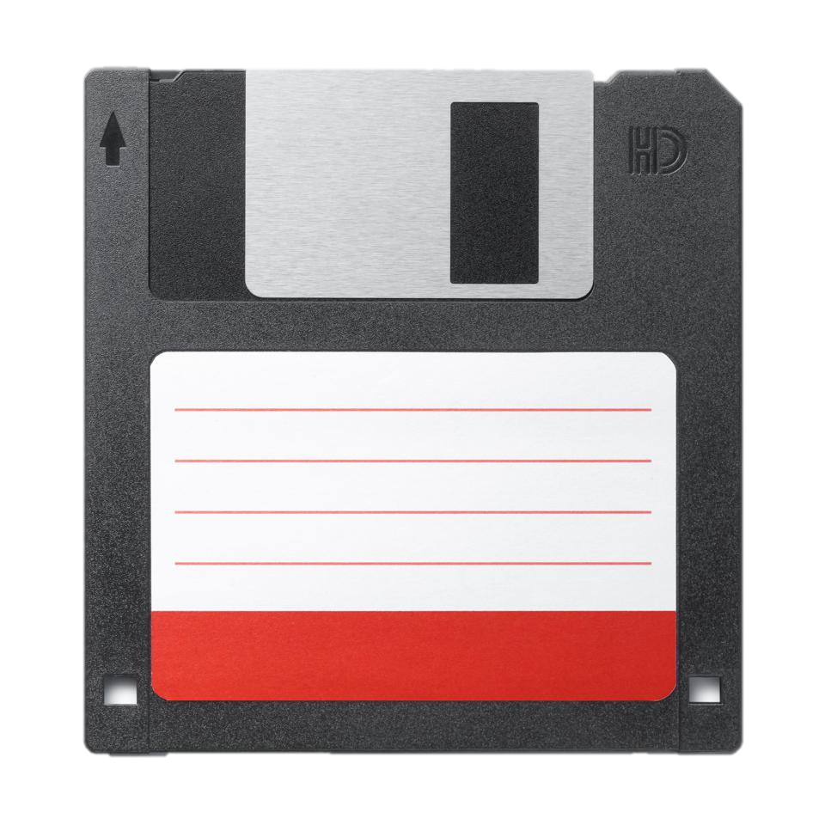
Floppy
A floppy disk or floppy diskette is a type of disk storage composed of a thin and flexible disk of a magnetic storage medium in a square or nearly square plastic enclosure lined with a fabric that removes dust particles from the spinning disk. Floppy disks are read from and written to by a floppy disk drive. Size is about 1.44 MB or 2.8 MBs.

Slide 25
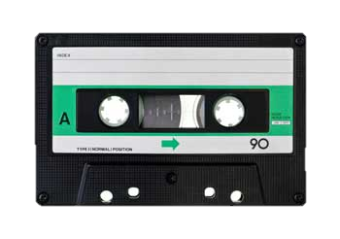
Audio Tapes
The Compact Cassette or Musicassette, also commonly called the tape cassette, cassette tape, audio cassette, or simply tape or cassette, is an analog magnetic tape recording format for audio recording and playback.
each second of recording carries 25 such frames which is 6,7 megabytes. each minute of recording carries then 60 times more which is about 403MB (almost a half of GB) each hour of recording is then about 23 GB. typical cassette was 180 minutes long which makes it capable of storing about 69 GB of information.

Slide 26
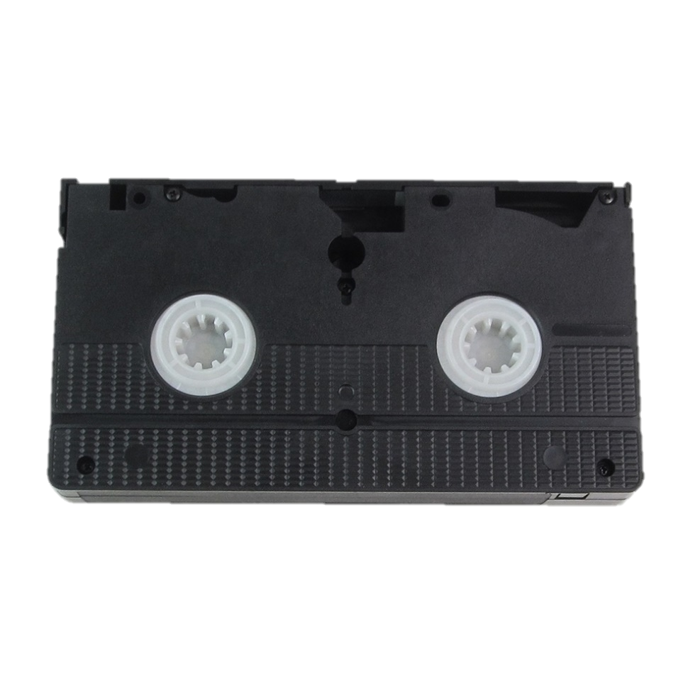
Video Tapes
Videotape is magnetic tape used for storing video and usually sound in addition. Information stored can be in the form of either an analog signal or digital signal. Videotape is used in both video tape recorders or, more commonly, videocassette recorders and camcorders.

Slide 27
Questions:-
1. Name any 5 Brands of HDD Manufacturers ?
2. Whats the Meaning of CD-R, RW & ROM ?
3. Cache Memory is ___________ Memory (Volatile/Non-Volatile)
4. BIOS memory is a type of _________ Memory ? (ROM/RAM/Firmware)
5. Frequency of RAM is measure in ___________ ?
Solve all question and comment down answers...

